Slide 1
ORCID for Researchers
OPSITARA Research Symposium
30/11/2023 – 01/12/2023
Dr Alex Freemantle – ORCID Lead, Royal Society Te Apārangi 0000-0002-0535-0662

Slide 3
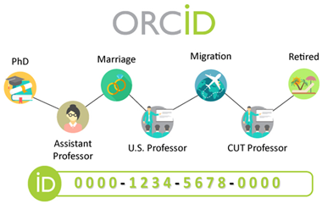
What is ORCID?
A free online profile about your professional activities from your research career
You can gather all your employment affiliations, research outputs, and professional activities in one place
It makes your life easier!
Saves you time
Easy to use
Notes:
ORCID makes your life easier as you build or manage your career. It is a free, easy-to-use, online profile that you control, where you can gather all your professional affiliations, research outputs, and activities in one place.
Uniquely yours
Name flexibility
More time for research
Reduced administrative burden
Portable profile

Slide 4
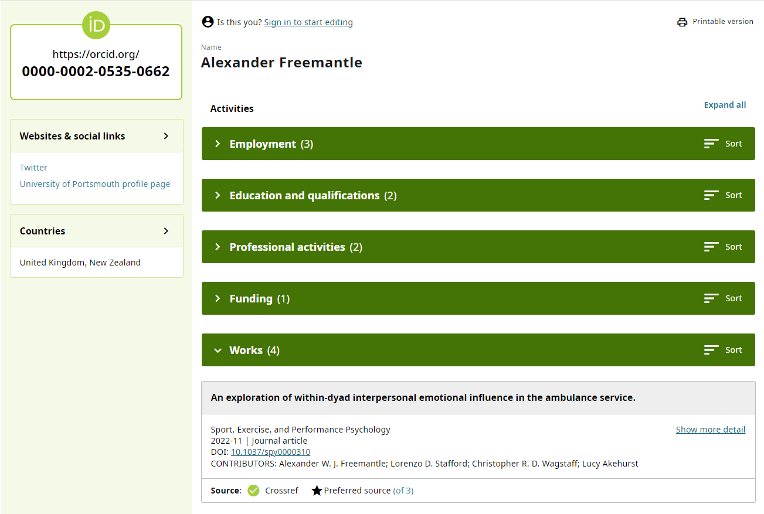

Slide 5
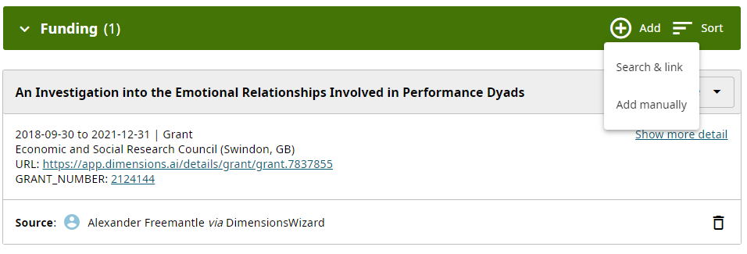
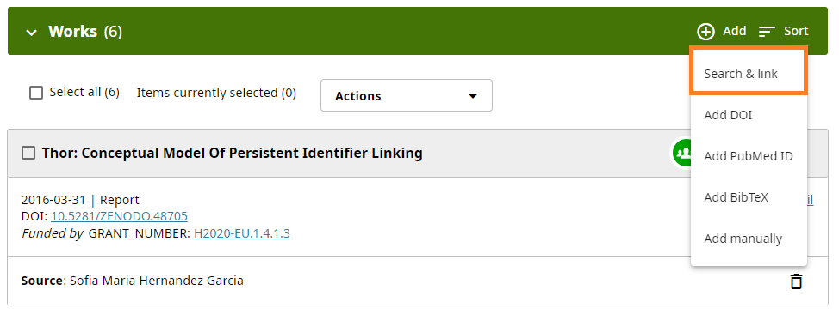
Populating your Records
Education and Qualifications
Funding
Search & Link -> Dimensions Wizard
Works
-
Scopus
CrossRef
Web of Science
DataCite
ISNI

Slide 6
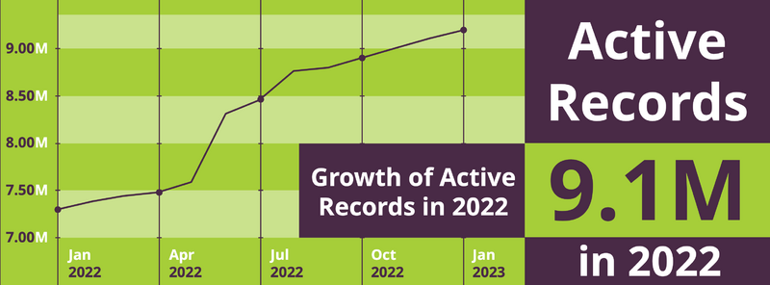
How is ORCID different?
ORCID records include more than just works information
Accurate attributions
Information can be verified using the source
Name disambiguation
A unique persistent identifier
Interoperable integrations allow for the removal of administrative burden
You control the security
Trusted by the sector

Slide 7
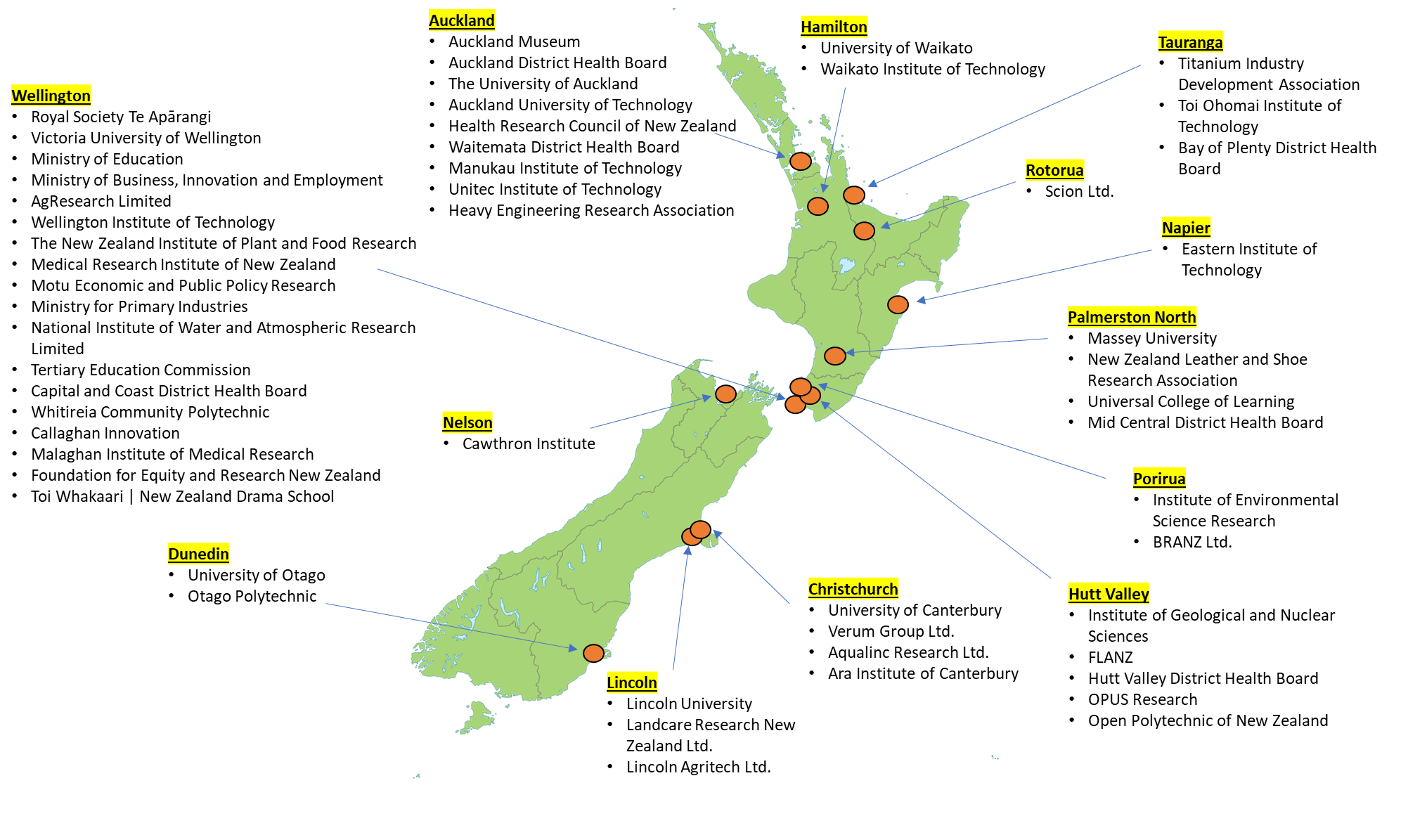
The New Zealand ORCID Consortium

Slide 8
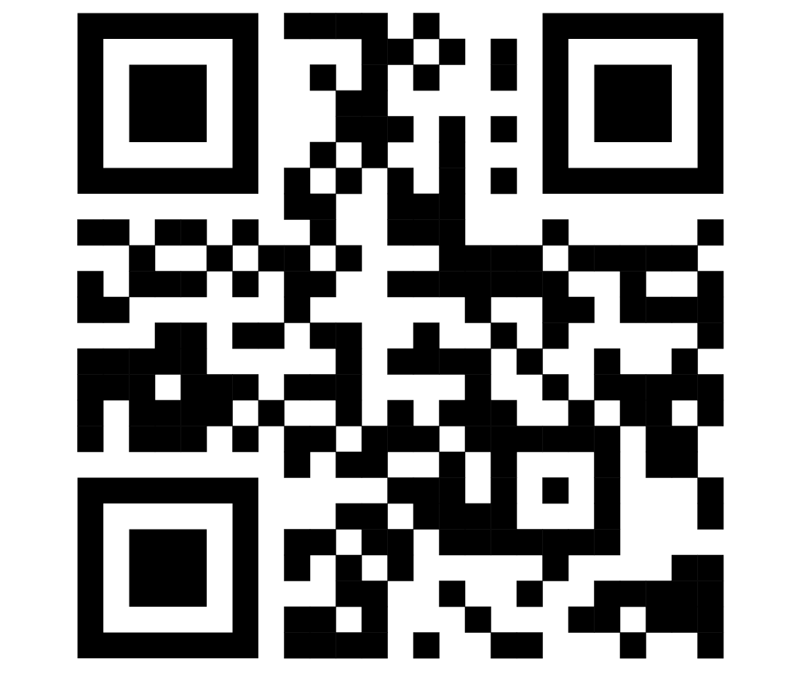
Visit ORCID.org to sign up for a free ORCID account now!
Any question? orcid@royalsociety.org.nz

