Slide 1
Catalyst Fund - advancing global science partnerships for New Zealand
The “Catalyst Fund” is the new name for the International Relationships Fund appropriation within Vote Business, Science and Innovation.
Supports activities that initiate, develop and foster collaborations leveraging international science and innovation for New Zealand’s benefit. The Catalyst Fund is delivered through four instruments:
Catalyst: Influence
Catalyst: Leaders
Catalyst: Seeding
Catalyst: Strategic

Slide 2
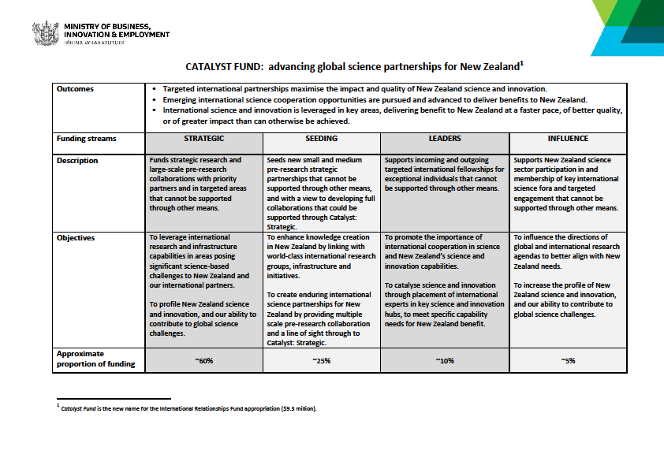

Slide 3
Catalyst: Seeding
Facilitates new small and medium pre-research strategic partnerships that cannot be supported through other means, and with a view to developing full collaborations that could be supported through Catalyst: Strategic over time.
Three annual calls
Call | Open Date | Close Date | Programmes
JANUARY | 30 January 2020 | 23 April 2020 | General
APRIL | 30 April 2020 | 16 July 2020 | General New Zealand - Germany Science & Technology Programme
JULY | 30 July 2020 (TBC) | 15 October 2020 (TBC) | General New Zealand – Japan Joint Research Programme Dumont d’Urville NZ-France Science & Technology Support Programme

Slide 4
Catalyst: Seeding General
Background
Supports new small and medium pre-research strategic partnerships that cannot be supported through other means, and with a view to developing full collaborations that could be supported through Catalyst: Strategic Fund.
Objective
To enhance knowledge creation in New Zealand by linking with world-class international research groups, infrastructure and initiatives,
To create enduring international science partnerships for New Zealand by providing multiple scale pre-research collaboration and a line of sight through to Catalyst: Strategic.
International Partner and Field of Research
open to collaborations with researchers from any country within all fields of research, science and technology.
Funding
A maximum of NZ$80,000 (GST Exclusive) in total is available per Proposal for projects lasting up to two years.
Allowable expenses:
Travel, research expenses, expenses related to hosting workshops

Slide 5
Catalyst: Seeding bilateral programmes
New Zealand – Japan Joint Research Projects
Max funding $60,000 per proposal for up to two years
Funding up to NZ$180,000 has been allocated to support New Zealand – Japan Joint Research Projects
Dumont d’Urville New Zealand-France Science and Technology Support Programme
Max funding NZ$80,000 per proposal for up to two years.
Funding up to NZ$160,000 has been allocated to support the Dumont d’Urville Science and Technology Programme
New Zealand-Germany Science & Technology Programme
Max funding NZ$80,000 per proposal for up to two years.
Funding up to NZ$240,000 has been allocated to support the programme
Field of Research – must be related to Climate Change (physical processes, social-economic dimension and adaptation - TBC)

Slide 6
Catalyst: Seeding
Programme | Partner | Application(s) Required | Allowable expenses | NZ$ Funding (GST exclusive)
General | International | New Zealand | Travel, research expenses, expenses related to hosting workshops | Up to $80,000 in total for up to two years
Sub-Programme
New Zealand – Germany Science & Technology Programme | Germany | New Zealand and Germany | Travel, research expenses, expenses related to hosting workshops | Up to $80,000 in total for up to two years
Dumont d’Urville NZ-France Science & Technology Support Programme | France | New Zealand and France | Travel, research expenses, expenses related to hosting workshops | Up to $80,000 in total for up to two years
New Zealand – Japan Joint Research Projects | Japan | New Zealand and Japan | Travel, research expenses, expenses related to hosting meetings | Up to $60,000 in total for up two years

Slide 7
Catalyst Seeding assessment criteria
Criterion 1: Enduring collaboration (weight in assessment 30%)
Track record of the New Zealand PI and Collaboration Partner (relative to opportunity)
Clearly demonstrated excellence of the Partner Institution(s)
Potential of the collaboration to create an enduring partnership.
Ability of the Project Team to deliver on proposed activities.
Criterion 2: Novel knowledge and partnership (weight in assessment 40%)
How the Collaboration Partner will bring world-leading knowledge that complements the New Zealand Project Team members’ skills and knowledge.
How the proposed collaboration will support a new partnership or a new research focus for an established collaboration.
Criterion 3: Strategic benefits (weight in assessment 30%)
Ability to leverage international investment, facilities and infrastructure not available in New Zealand.
Clearly demonstrated pathway to build a substantive collaboration beyond an initial engagement that is in line with New Zealand’s science priorities.
Ability of Project Team to use the partnership to initiate links with relevant New Zealand research capabilities beyond the participating institutions.

Slide 8
Criteria 3: Criterion 3: Strategic benefits Contineud
Clearly demonstrated pathway to build a substantive collaboration beyond an initial engagement that is in line with New Zealand’s science priorities.
New Zealand science priority may refer to high priority research fields as evidenced by links to a CoRE, NSC, biodiversity documents, local government priorities, or any other science priority argued in the proposal.

Slide 9
Catalyst: Leaders
Supports incoming and outgoing targeted international fellowships for exceptional individuals that cannot be supported through other means
Three annual calls
Call | Open Date | Close Date | Sub-programmes
JANUARY | 30 January 2020 | 23 April 2020 | International Leader Fellowships New Zealand - China Scientist Exchange Programme JSPS Postdoctoral Fellowships
APRIL | 30 April 2020 | 16 July 2020 | Julius von Haast Fellowship
JULY | 30 July 2020 (TBC) | 15 October 2020 (TBC) | HOPE Meeting (TBC)

Slide 10
Catalyst: Leaders
Sub-Programme | Brief Description | Duration | NZ$ Funding (excl. GST) | Awards
International Leader Fellowships | Supports exceptional individuals from any country outside New Zealand to catalyse science and innovation capability and capacity in New Zealand for a minimum of 4 weeks per year for up to 3 years | 1 to 3 years | Per annum: $20,000 Stipend $20,000 Research $10,000 Host admin | Up to 3
Julius von Haast Fellowship Award | Supports an internationally recognised researcher from Germany to undertake research in New Zealand for a minimum of 4 weeks per year | 3 years | Per annum: $20,000 Stipend $20,000 Research $10,000 Host admin | Up to 1
NZ-China Scientist Exchange Programme | Supports the development of research linkages with China by enabling New Zealand researchers to visit Chinese research organisations | 4 weeks | Flights and daily living allowance | Up to 10
JSPS HOPE Meeting | Supports excellent PhD students and/or young researchers to attend the HOPE meetings with Nobel Laureates in Japan | 5 days | Flights, accommodation, and meeting registration | Up to 5
JSPS Postdoctoral Fellowship* | Supports young and excellent New Zealand postdoctoral researchers doing research in Japan | 12 – 24 months | Flights, insurance and living allowance | Up to 5

Slide 11
International Leader Fellowship
Background
The Programme enables a Fellow to catalyse science and innovation capability and capacity development in New Zealand for a minimum of four weeks per year for up to three years.
Objective
To support the attraction by New Zealand Research Organisations (the Hosts) of international fellows who can have a catalytic impact on New Zealand science capabilities and promote the importance of international cooperation in science.
International Partner and Field of Research
open to researchers from all countries and all fields of research, science and technology.
Funding (per annum for up to three years)
NZ$20,000 maximum stipend paid to the Leader via the New Zealand Host;
NZ$20,000 maximum research and travel allowance paid to the Host; and;
NZ$10,000 maximum host institution administration allowance paid to the Host.

Slide 12
New Zealand-China Scientist Exchange Programme
Objective
Encourage and facilitate greater understanding and development of research linkages between the two countries in jointly agreed priority research fields for collaboration.
Activity Description
Enable up to 10 excellent New Zealand researchers to travel to mainland China and collaborate with researchers in mainland Chinese institutes for a four-week period (2-6 weeks)
The New Zealand researchers can visit more than one Chinese research institute as part of the exchange.
Beijing Orientation
Exchange is expected to start with orientation ceremony in Beijing on 20 October.
Funding
Travel, accommodation and daily allowance (no funds for research costs).
Traveler is is responsible for their own visa application, travel and medical insurance
Fields of Research
Preference will be given to those applications under the listed priority research fields:
Water Research
Food Safety and Security
Non-communicable disease.

Slide 13
Catalyst Fund - advancing global science partnerships for New Zealand
How to apply:
Applications must be submitted through Catalyst Fund Application Portal
Contact your Research Office for log-in details
Current open call (January) closes on Thursday 23 April, 2020

Slide 14
Human Frontier Science Program
Aim of the Program is to promote, through international cooperation, basic research focused on the elucidation of the sophisticated and complex mechanisms of living organisms for the benefit of humankind.
New Zealand is a member country.
HFSP Research Grants support innovative basic research into fundamental biological problems with emphasis placed on novel and interdisciplinary approaches that involve scientific exchanges across national and disciplinary boundaries
Projects should challenge existing paradigms by using novel approaches and techniques. Applications for high-risk/high-reward projects are particularly encouraged

Slide 15
Human Frontier Science Program
Research grants are provided for teams of scientists from different countries who wish to combine their expertise in innovative approaches to questions that could not be answered by individual laboratories. Preliminary results are not required and applicants are expected to develop new lines of research through the research collaboration.
Types of awards
Program and Emerging Investigator Grants
Long-term and Cross-Disciplinary Postdoctoral Fellowships
Value and duration of awards
Research Grants – Maximum US$450,000 p.a. - 3 years for teams of 4 members
Fellowships - living allowance as well as a research and travel allowance, 3 years
Timetable
Research Grants – 2 stage process, Letter of Intent closes 30 March (register before 19 March)
Fellowships – applications close in August

Slide 16
Address fundamental life science questions with collaborations from from disciplines outside the traditional life sciences such as biophysics, chemistry, computational biology, computer science, engineering, mathematics, nanoscience or physics
Truly interdisciplinary – project can only succeed because of the interdisciplinary collaboration
International/Intercontinental
Not continuation of current research
Projects are expected to be at the frontiers of knowledge and therefore entail risk Projects should challenge existing paradigms by using novel approaches and techniques. Applications for high-risk/high-reward projects are particularly encouraged
Applicants are expected to develop new lines of research through the collaboration
https://www.hfsp.org/

Slide 17
HFSPO funds basic life science research. HFSPO does not fund the following:
1. Projects of a purely applied nature. For example:
• projects of a primarily clinical and pharmaceutical nature are only considered if they allow new insights into fundamental biological mechanisms of disease;
• projects aimed at developing methods of diagnosis or treatment, including the search for potential drug targets or advanced trials of drugs under development;
• applied research in engineering, biotechnology, or nanotechnology, that does not address a fundamental biological problem;
• projects directly concerned with agricultural problems such as crop yield or breeding and environmental problems such as pollution.
2. Research aimed at developing novel methods or the study of analogs or models of biological activity unless these methods allow new biological questions to be answered in the context of the aim of the HFSP to fund fundamental research.
3. Observational projects or systematic screening approaches.
4. Large-scale data collection as such, unless there is a convincing rationale for the collection and detailed methodology for the data analysis; this includes the systematic multi-species-omic analyses of populations or ecosystems, which do not address a fundamental biological question of general interest. However, studies of the mechanisms of species-species interactions or their co-evolution are eligible.
5. Research in for-profit environments (but collaborations are allowed).

Slide 18
Expression of Interest for Catalyst Reviewers:
To be considered for January Call, EOIs must be received 3 weeks before call closing date
For more information:
https://royalsociety.org.nz/what-we-do/funds-and-opportunities/catalyst-fund/reviewing-proposals/

Slide 19
For more information
Troels Petersen
Programme Manager - Research Fellowships & International
(04) 470 5764
Catalyst Fund (RSNZ)
Email:International.Applications@royalsociety.org.nz
Website:
https://royalsociety.org.nz/what-we-do/funds-and-opportunities/catalyst-fund/

