Slide 1

Research Data Management, Persistent Identifiers & ORCID at Waipapa Taumata Rau

Slide 2
Overview
Integrated Framework for Research Data Management (RDM)
  Origins, stock take and recommendations
  RDM Programme (2022-2024) Initiatives
Persistent Identifiers (PIDs) initiative
  Overview and priorities
ORCID implementation
  Current metrics
  Existing and planned activity
Notes:
Persistent Identifiers and ORCID work is situated within a wider Research Data Management project.

Slide 3
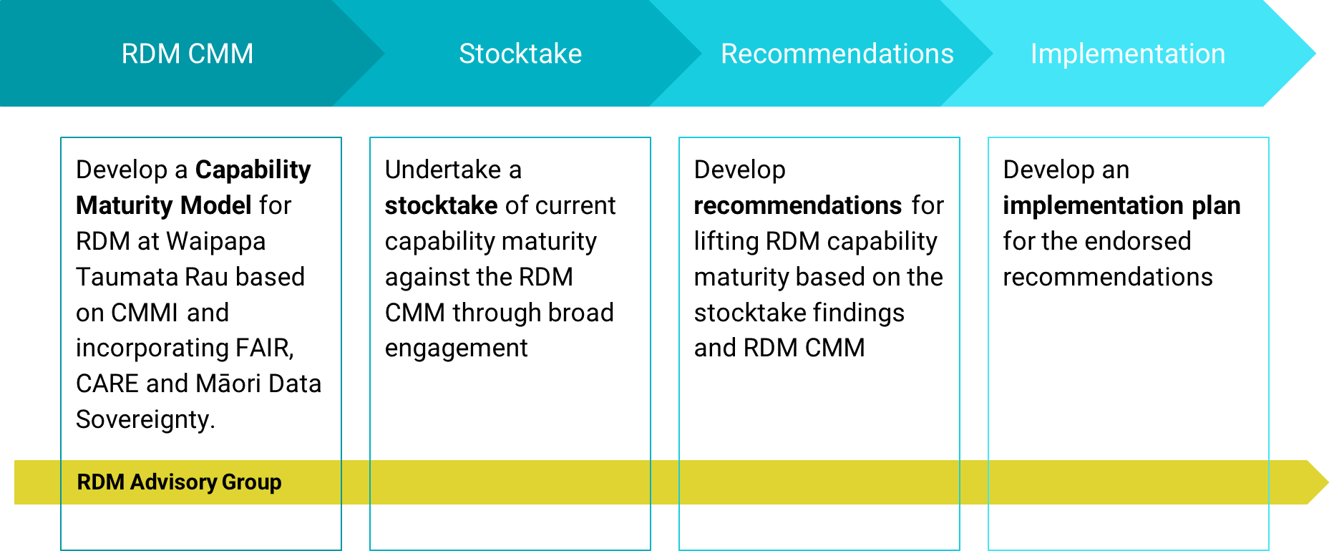
RDM Project – background and aims
Notes:
2020 - University started work towards an integrated framework for Research Data Management. Driven by changing landscape (e.g., funder/publish requirements; ethical frameworks re. research data) and institutional need (data = strategic asset).
An RDM Project Team was formed to review and assess the situation. Worked through these steps. CCM = 6 dimensions assessed over 5 levels. Waipapa Taumata Rau Research Data Management Capability Maturity Model v1.2 Research Data Management Project. The University of Auckland. Model. https://doi.org/10.17608/k6.auckland.16993660.v1
Stocktake = low level of institutional maturity across all six dimensions.
19/20 identified opportunities endorsed.

Slide 4
Improving RDM capability maturity
Policies and resources
New RDM policy & guidance
Open Access Policy
Research Code of Conduct (under review)
Researcher skills
Ongoing skills development (including around RDM and in Māori Data Sovereignty)
Māori Data Sovereignty
Poutiaki Rangahau Māori
RDM Programme (2022-2024)
Secure Research Environment (SRE)
machine-actionable Data Management Plan (maDMP)
Persistent Identifiers (PIDs) - connected ecosystem
Notes:
Recommendations to improve RDM capability maturity included a mix of:
Inflight activities and BAU improvements e.g., policy
Strategic initiatives
New roles
And, improvements requiring strategic investment = RDM Programme.
Funded to design and deliver a subset of the recommendations made to uplift data management security.
SRE is looking to create an environment that enables secure upload, storage, processing and analysis of data.
maDMP is looking to develop a connected tool that facilitates dynamic data management planning.
PIDs initiative is concerned with connecting our research ecosystem through linked persistent identifiers and enabling robust information flow between our internal systems.

Slide 5





PIDs initiative – priorities and benefits
People | ORCID
Organisations | ROR
Research Outputs | DOI
Instruments | PIDINST
Research projects | RAiD
Disambiguate
Maintain accurate affiliations
Enhance discoverability
Reduce data entry
Enable FAIR data
Increased trust
Notes:
One part of developing an RDM framework is the identification of research data and its connection to other entities. Our priortised entities and their associated PIDs.
Each individual PID offers BENEFITS, some of which are commonly shared e.g., disambiguation. But PIDs also enable clear, reliable and unambiguous connections between entities, helping to consistently describe research and make it more readily discoverable.
Dual focus – 1) adoption and promotion of these priority PIDs across our community and into our university systems, and 2) to connect them into an information network.

Slide 6
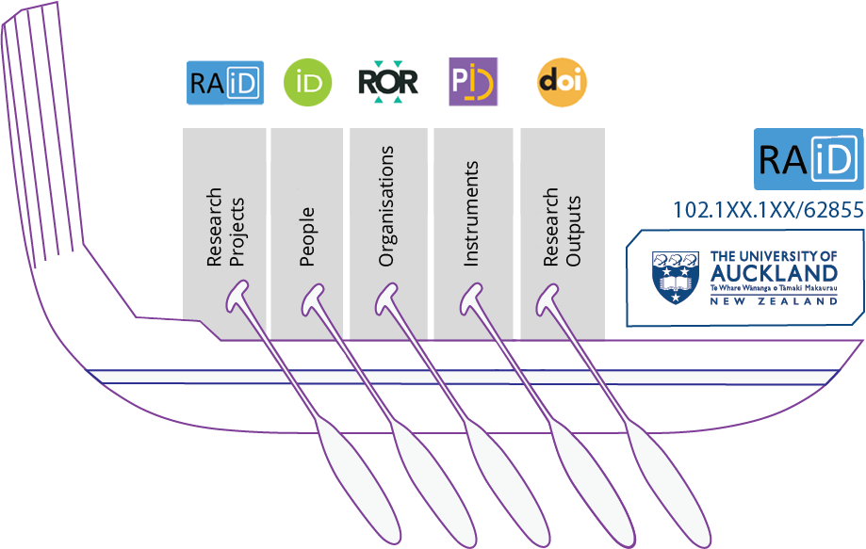
PIDs initiative - approach
Embed Phase
  Increase awareness
  Promote benefits
  Clear processes to create and use
  Support and guidance on usage
Connect Phase
  Introduce RAiD
  Community priorities
  Design first interconnections
Notes:
Two-phase implementation approach.
1) Embed without interconnection – community to understand the benefits and how to achieve.
2) Looks at connecting PIDs and our research ecosystem through RAiD – the Research Activity identifier.
Our wah-ka here represents the encompassing nature of RAiD, and that while itself an identifier for research projects, it is also a metadata record collecting other PIDs and describing the relationship between them. It is this part that facilitates explicit connections and enhances the visibility of the research activity; including, recording a timeline of project interactions.
Principle Investigator & PhD journeys were prioritised for PIDs integration. Looking at how to use PIDs in our digital ecosystem to reduce administrative burden through the automation of data entries, wherever possible. PIDs > information flow b/w systems > allows linkage between data associated with research inputs and outputs (e.g., publications – grants; scientific output & instrument). Advantages = data reproducibility and openness, but could afford new understanding of our research impact.

Slide 7
ORCID implementation
Current metrics
  10,400 public academic and doctoral candidate profiles
  27% academics and 22% PhD – attached to Research Outputs
  21% academics and 28% PhD – attached to NZ ORCID Hub
Existing activities
  Guidance for doctoral students to create iD
  Guidance for academics to create iD and connect record
  Doctoral Induction Workshop
  Raising your Research Profile Workshop
Notes:
More mature, well-known, but estimate of our current ORCID usage is low. NB. Elements not ORCID membership affiliation reports.
Despite some of the existing activity to encourage use of ORCID –less than 30% of uptake across Research Outputs and NZOH attachment for both academics and students.
More to do to promote the benefits of ORCID and drive uptake.
One goal was to provide accurate, consolidated and relevant ORCID guidance. Engaging with key stakeholders, we recently co-designed a single, action-orientated online resource for ORCID.

Slide 8
ORCID uptake and benefits
Propose uptake activities
  Staff and student onboarding processes
  New staff inductions
  Institutional signatures
  Annual revitalisation days
  Targeted communications
Proposed development activities
  Up-to-date ORCID records
  Up-to-date Research Output profiles
  Reduced data entry
Notes:
Research community is dynamic, so ORCID uptake will require a sustained effort.
Tapping into our staff and student onboarding & registration processes to capture ORCID at the first point of entry to the University. Not mandated, but a proactive approach.
Feeding into a new induction for research staff.
Re-investigating the appetite for standardised institutional signatures.
Working with our colleagues in the Library and Learning Service (central contact) and NZOH to design and plan annual revitalisation days.
Targeting our research staff (through emails and campaigns) to promote the benefits of ORCID AND support robust records (e.g., duplicates; affiliations; displaying).
Driving benefits:
Add to the attested information currently enabled through the NZOH (e.g., writing internal award & distinction information to ORCID records).
Connect our institutional Figshare with Research Outputs so that authors can claim those deposits.
Reduce the avenues for signing up for ORCID OR to other places (avoid double handling).

Slide 9

Questions?
Contact:​
Ruth Wilson - Engagement Specialist ruth.wilson@auckland.ac.nz

