Slide 1


The experience at Victoria University of Wellington
Matt Plummer and Katie Wilson

Slide 2

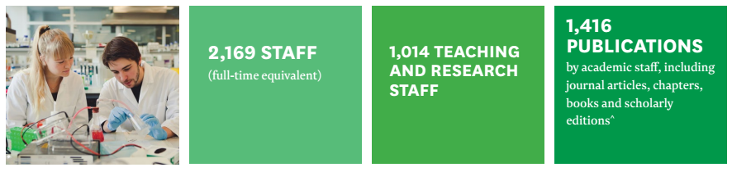
Victoria at a glance

Slide 3

CC BY-SA 2.0 Ron Mader, colours altered from original

Slide 4
ORCiD communications plan
  VC Column in Victoria News
  Victoria News stories
  Website
  Subject librarians
  Faculty, PG newsletters
  Stand at ResBaz
  Digital displays

Slide 5

Digital display text

Slide 6
What we’ve done
Integrated ORCID into Elements
Embedded ORCID in metrics, PBRF workshops
Individual consultations
Ongoing articles in VicNews
Set up orcid@vuw.ac.nz email
ORCID popups in public spaces
Steady increase in registrations

Slide 7
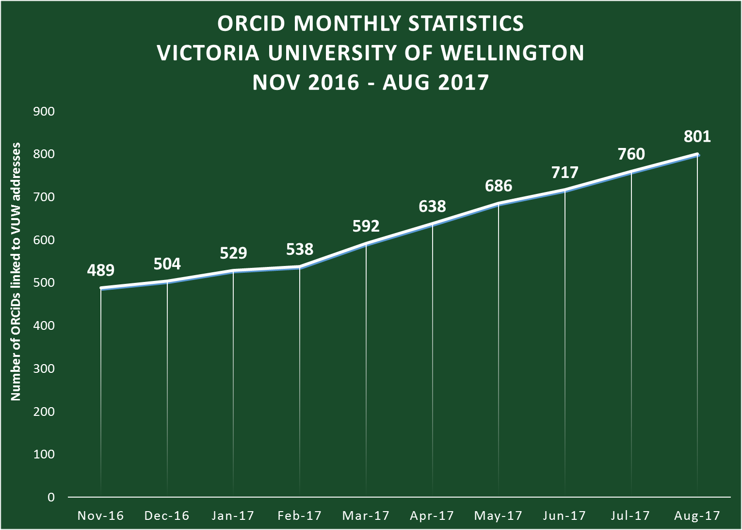

Slide 8
Challenges
Communicating the benefits of ORCID iDs
Motivating all researchers to create & populate an ORCID iD
Positioning ORCID within the research environment

Slide 9
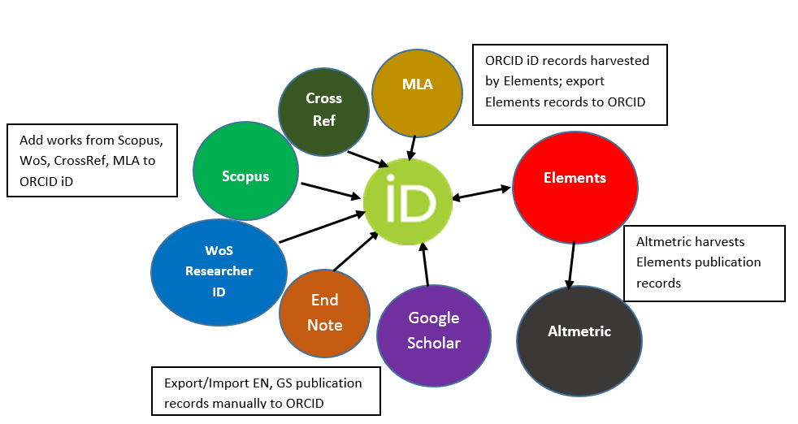
ORCID iD –> Elements -> Altmetric

Slide 10
Where to next?
Leveraging benefits of Consortium membership, and the New Zealand Orcid Hub, to offer added value to researchers
Further integrations investigated ( eg HR, Finance, Grants Management)
In the meantime, promote utilisation without these integrations (Non-tuakiri option)
Targeted communication – from IT architects to humanities academics and everyone inbetween
Strengthen steering group processes for support, promotion and governance

Slide 11


