Slide 1
Early to Mid-Career Fellowship Roadshow
Rutherford Discovery Fellowship
Rutherford Foundation Postdoctoral Fellowship
JSPS Postdoctoral Fellowship
Human Frontier Science Program Fellowship
March 2023

Slide 2

About the Society:
  Representation for ~1,600 members and ~20,000 constituent members
  Operates under an act of parliament (focus strategic priorities)

Slide 3

Who are we?
We support New Zealanders to explore, discover and share knowledge
Administer Government Research Funding Contracts
Projects
Fellowships
International Relationships
Celebrate Excellence in Science and Humanities
Fellows and Companions
Medals and Awards
Annual Research Honours Dinner
Science Media Centre
Help connect media with the scientific community
Science Media SAVVY workshops
Primary/Secondary Schools
Science Teacher Leadership Programme
Stimulate curiosity for/interest in Science and Technology (CREST, Powering Potential)
Engagement, outreach, expert advice
Public Lecture series
  Speaker’s Science Forum
Emerging issues papers
New Zealand science journals

Slide 4
Early to Mid-Career Fellowship Opportunities
Fellowship | PhD conferred | Citizen/ permanent resident | Support | More info | Call open
Rutherford Foundation Postdoctoral Fellowship | ≥ 01 Jan 2019 (4 years post Phd) | yes | 2 years, 170,000 | Web | 08 Jun - 03 Aug
Rutherford Discovery Fellowship | 1 Jan 2015 to 31 Dec 2020 (3-8 years post PhD) | Yes | 5 years, 800,000 | Web | 02 Mar - 27 April
JSPS Postdoctoral Fellowship (for research in Japan) | ≥ 2 Apr 2017 (0-6 years post PhD) | Must give preference to NZ citizens/residents | 1-2 years, monthly allowance ¥362,000 + extra | Web | 26 Jan – 20 April
Human Frontier Science Program (HFSP) Long-Term Fellowship (3 years) Cross-Disciplinary Fellowships (3 years) | PhD conferred by start (no later than 31 Dec 2024) up to 3 years post PhD (28 Sept 2020) | NZ citizens can work in all countries. Non-NZ citizens can apply to work only in a research institution in one of the member countries. | 3 years (last year can be deferred or in home country) | Web | EOI by 11 May

Slide 5
The Rutherford Foundation
Objectives
The objectives of the Rutherford Foundation Fellowships and Scholarships are to support the education and development of promising excellent early career researchers with the potential to excel in a research environment. The funding opportunities support early career researchers who demonstrate a passion for research, science and technology, and have a strong sense of the purpose and benefits of research to New Zealand. Receipt of a Rutherford Foundation award is expected to have a significant value in the future career development of the supported Scholars and Fellows and help them to establish a foundation on which to embark on an independent research career.
Funding opportunities:
  Rutherford Foundation Postdoctoral Fellowship
  Cambridge-Rutherford Memorial PhD Scholarship

Slide 6

The Rutherford Foundation
  New Zealand Postdoctoral Fellowships
    2 years
    $75,000/year salary stipend
    $10,000/year research expenses
    Eligibility: 0-4 years post PhD

Slide 7
Rutherford Foundation Postdoctoral Fellowship
  Eligibility Criteria
  Proposals will be considered from all fields of research, science and technology (including social sciences and the humanities)
  Applicants are required to have had their PhD conferred no more than four years prior to the year the award is awarded. For the 2023 funding round, the PhD must be conferred after the 1st of January 2019.
            An exemption to this clause can be sought to allow applicants to demonstrate that their PhD has been submitted and can be examined by the date of short-listing.
            A further exemption can be sought to demonstrate a reasonable absence from a research career, for instance to take parental leave or for extended sickness leave.
            Exceptions requires prior approval from Secretariat
  Applicants must be either New Zealand citizens, or have continuously resided in New Zealand for at least two years immediately prior to their application and hold, or are deemed to hold, a New Zealand resident visa.

Slide 8
The Rutherford Foundation
Focus on career development, not business as usual (don’t stay with your PhD host and/or supervisor unless you can justify good reasons for doing so).
Additional focus
  strong sense of the purpose and benefits of their research to New Zealand
  a passion for research, science and technology
  potential to excel in a research environment.
Application dates:
  Open on 08 June and close 03 August (also 03 August deadline for referee reports)
  For more information:
  https://royalsociety.org.nz/what-we-do/funds-and-opportunities/rutherford-foundation/
Notes:
Focus on career development
More likely to be awarded to someone who moving to a new institution with a new supervisor rather than someone continuing on from their PhD with same supervisor at the same institution.
This does not mean you can’t stay at the same institution. However, you have to argue strongly for why this would be the best choice for your career.

Slide 9
Japan Society for the Promotion of Science (JSPS) Postdoctoral Fellowships
For research in Japan with a Japanese Host for 12-14 months
Fully funded by the Japan Society for the Promotion of Science.
Society can nominate up to 4 fellowships in this funding round, depending on the quality of applications received.
Value of the Award
  The award will cover:
  A round trip air-ticket (based on JSPS regulations)
  A monthly maintenance allowance of ¥362,000
  A settling in allowance of ¥200,000
  Overseas travel accident and sickness insurance coverage.
A programme under Catalyst Leaders, administrated by Royal Society Te Apārangi.
Apply through Catalyst Leaders

Slide 10
Eligibility JSPS – Postdoctoral Fellowships
Start date:
JSPS requires that awarded Fellowships commence between 1 April 2023 and 30 November 2023. For FY2023 the Society strongly recommends a Start between 01 September – 30 November to allow for JSPS processing time.
Applicants must meet all of the JSPS criteria:
  Applicant must hold a doctorate degree, or be scheduled to receive a doctorate degree before the chosen start date of the Fellowship.
  The doctorate degree must have been awarded on or after 2 April 2017.
  Applicants must have arranged in advance a research plan with their host in Japan
When nominating candidates to JSPS, the Society must give preference to New Zealand citizens or permanent residents.
How to apply: Submit application through the Society’s Catalyst Fund Application Portal. Closing date: 20 April, 20
More Information: Catalyst: Leaders website:
https://royalsociety.org.nz/what-we-do/funds-and-opportunities/catalyst-fund/catalyst-leaders/

Slide 11

Human Frontier Science Programme (HFSP) Postdoctoral Fellowships
HFSP promotes and funds basic research
  innovative, cutting edge research to extend the frontiers of life sciences
  focused on the elucidation of the sophisticated and complex mechanisms of living organisms
HFSP attaches the highest importance to
  scientific merit or proposed research
  internationality (especially intercontinentality) and
  interdisciplinarity
  New Zealand a member since 2006

Slide 12
Human Frontier Science Programme (HFSP) Postdoctoral Fellowships
Type of HFSP Fellowships
Long-Term Fellowships - postdocs in the life sciences
Cross-Disciplinary Fellowships - postdocs from non-biological sciences
3 years (3rd year can be deferred for two years or be back in home country)
amount depends on the country; travel and possibly child and parental leave allowances
For ambitious postdoctoral scientists to
undertake frontier research (read assessment criteria for more information)
move into new areas of study
work in a new country
broaden research skills and learn new methodology
work in a top laboratory

Slide 13
Human Frontier Science Programme (HFSP) Postdoctoral Fellowships
  General eligibility criteria
  Work in a new country
    Citizen of a HFSPO Member? Choose anywhere
    Not from a Member country? Choose a lab in a Member country.
  Apply within 3 years of Ph.D. (PhD conferred no later than start of fellowship)
  Must have one first-authorship paper
  Two stage application process
    Letter of intent by 11 May, 2023
    Full proposal for invited applicants 28 September, 2023
  ~65 fellowships per year (success rate ~ 12%.)

Slide 14
Rutherford Discovery Fellowships
  The Rutherford Discovery Fellowships support New Zealand’s most talented early- to mid-career researchers.
  The Fellowships will develop and foster the future leaders in the New Zealand research, science and innovation sector. It will help them to develop a strong track record and allow them to compete with the best researchers in New Zealand and the world for mainstream research funds
  Aims to assist with the retention and repatriation of New Zealand’s top early- to mid- career researchers with international research experience
  Ten prestigious Fellowships of five years in length will be awarded on a competitive basis annually, for research based in a New Zealand host institution.

Slide 15
Eligibility
PhD must be conferred between 01 January 2015 and 31 December 2020
Applicants must:
  be either New Zealand citizens or applicants who have continuously resided in New Zealand for at least three months prior to their application and hold, or are deemed to hold, a New Zealand resident visa.*
  be associated with a New Zealand-based research institution that can provide the appropriate support and facilities to enable the applicant to succeed in their Fellowship for the full five years of the Fellowship's term.
*An opportunity exists to grant an eligibility exemption for applicants on a work to residency visa if the applicant has demonstrated (and the Society is convinced of) a commitment to Aotearoa New Zealand. The type of questions we would ask are: Why are you in Aotearoa? How long have you been in Aotearoa? What is your current visa status? Please send evidence of your commitment to Aotearoa to Rutherford.Discovery@royalsociety.org.nz for approval of your eligibility exemption.

Slide 16
Eligibility exceptions
The eligibility period may be extended under the following scenarios:
Extended sickness leave or part-time employment as a result of ongoing childcare or other caring responsibilities. Calculate pro rata for the year count.
Eligibility can be extended to take into account any career interruptions experienced due to being the primary caregiver for young children born since their PhD was awarded. If the applicant is the primary caregiver of a dependent child, the applicant is able to extend the period of eligibility by two years per child. The extension of two years per dependent child is inclusive of any periods of parental leave. There is no maximum identified
All extensions need prior approval by the RDF Secretariat
Additional Rules
Where an applicant has previously submitted an unsuccessful application, they should discuss their subsequent application with the Fellowship Coordinator before reapplying

Slide 17
Scheme operation
  The award will provide:
    A contribution of $70,000 per year towards the researcher's salary
    An annual award of $60,000 in research related expenses
    $30,000 per year for the host organisations
  At least 85% of the Fellow’s time must be dedicated to the research objectives identified in the proposal
  Attendance at an annual workshop is required

Slide 18
Scheme operation
  About the 85% time must commitment
  Existing grants paying an FTE contribution (e.g. Marsen, HRC, Endevour etc.) should be incorporated into the overall proposed project and hence become part of the RDF objectives. For example, Marsden Fast-Start funding 0.2 FTE. Still committing 0.85 FTE to the RDF objectives, but since Marsden pays for 0.2 FTE, the FTE entered in the budget for the relevant years should now roughly be 0.85-0.2 = 0.65 FTE.
  Work part-time
  Applicants can choose to work part-time for family-reasons, e.g. 0.5 FTE. Would require an approved postdoc or RA working on the programme for the remainder of the 0.85 FTE, i.e. 0.35 FTE

Slide 19
Selection Criteria
Applications are graded on three criteria:
In the case of applicants of the same calibre, preference will be given to applicants who:
  do not already have tenure or equivalent; or,
  are living overseas and will use the Fellowship to return to New Zealand to continue their research careers
Criterion | Weighting
Research Quality
Calibre of the applicant as a researcher | 60%
Assessment of the proposed programme of research | 20%
Leadership Quality
Calibre of the applicant as a research leader | 20%

Slide 20
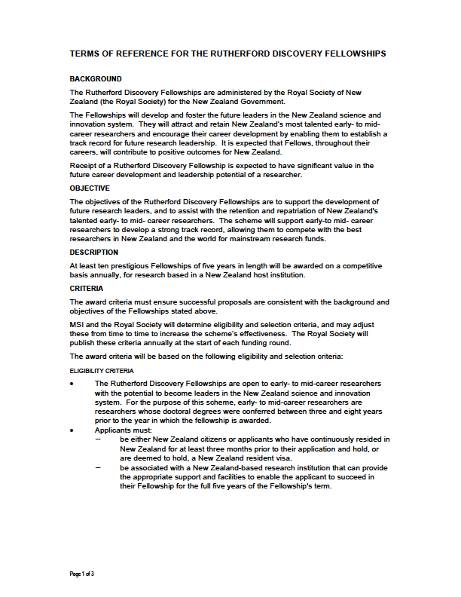
Are the Fellowships for you?
https://royalsociety.org.nz/what-we-do/funds-and-opportunities/rutherford-discovery-fellowships/
Use your support:
  Research office staff
  Mentors
  Head of Department
  Read all information available to you
Terms of
Reference
Proposal
Guidelines
Referee
Guidelines
Panellist
Guidelines

Slide 21
Funding round process
  A call for proposals will be made in early March
  Applicants will be required to submit their proposals along with three applicant-solicited referee reports using a web portal
  Three panels will assess the proposals:
    Humanities and the Social Sciences
    Life Sciences
    Physical Sciences, Engineering and Mathematics
  The discipline-based panels will recommend a long list of proposals to an interview panel co-opted by the President of the Royal Society Te Apārangi
  This interview panel will short list applicants to interview
  Ten Fellows will be appointed

Slide 22
Process of selection
Panel | No. of proposals submitted | Proposals submitted (% of total) | Long-list (number)
HSS | 16 | 14% | 6
LFS | 52 | 45% | 18
PEM | 47 | 41% | 16
Totals | 115 | 100% | 40
HSS
LFS
PEM
Discipline-based panel recommendation
6
18
16
Interview panel consideration
40
Call to interview
20

Slide 23
Terms of Reference
BACKGROUND
The Rutherford Discovery Fellowships are administered by the Royal Society of New Zealand (the Royal Society) for the New Zealand Government.
The Fellowships will develop and foster the future leaders in the New Zealand science and innovation system. They will attract and retain New Zealand’s most talented early- to mid-career researchers and encourage their career development by enabling them to establish a track record for future research leadership. It is expected that Fellows, throughout their careers, will contribute to positive outcomes for New Zealand.
Receipt of a Rutherford Discovery Fellowship is expected to have significant value in the future career development and leadership potential of a researcher.

Slide 24
Interview panel (Stage two)
The Interview Panel will conduct the interviews. This is a two-part process:
The Secretariat will produce a Long-list of the highest ranked applications from each discipline panel for the Interview Panel to consider. The Interview Panel may choose to additionally include proposals where there are extreme differences between the discipline panellists scoring.
The interview panel assesses the Long List to create a shortlist of applicants to be invited for interview. The applicants called to interview does not need to reflect the number of proposals in a particular discipline.
In addition to the weighted assessment criteria, the Interview Panel may look to the Background and Objectives of the Rutherford Discovery Fellowship Terms of Reference when making funding recommendation. This could include considerations of:
  Applicants’ leadership potential (e.g., including awareness and engagement where relevant with Vision Mātauranga)
  The contribution to positive outcomes for New Zealand
  Value in the applicant’s future career development

Slide 25

Preparing the application
  Follow the rules
  Writing tips:
    Write for your audience
    (Remember - majority if not all of discipline panellists
    are not experts in your discipline)
    Avoid jargon
    Make every sentence count
    Define abbreviations and use them sparingly
    Avoid excessive use of might, maybe, could perhaps
    Avoid grammatical and spelling errors
    Make it as clear as you can
  Read the guidelines (see how you will be assessed)

Slide 26
Preparing the application
Building your CV
In the Rutherford Discovery Fellowship applications, CVs matter!
  Apply for awards and grants
  Serve professional bodies (panels, editorial boards, conference committees… )
  Write those unwritten papers prior to applying
  Publicise your research
  Seek collaboration where this will benefit your research programme
NZ RS&T-CV template
  Use section 1d “Present research/professional speciality” to introduce your research field.
  Only part 1-2a required. You can chose to engage with section 2b-d if relevant, e.g. demonstrate relationship with end-users (iwi, industry, policy work etc.)

Slide 27
Preparing the application
Years of Research Experience
Applicants must enter their years of research experience
Whole number of years minus periods of parental leave, medical leave or other career interruptions
Part-time work calculated on pro rata basis (e.g. 2 years at 0.5 FTE counts for one year of research experience)
      Indicate parental leave and research breaks in section 1e “Total years research experience”, e.g.
        Part-time at 0.5 FTE 2016-18 for family reasons
        12 month parental leave 2015-2016

Slide 28
Preparing the application
Leadership
Use this space wisely, avoid repeating your CV (but could be used to expand on CV if needed) - - clarify your leadership/researcher capability where needed e.g. around co-authored papers
If applicable, write about the future direction of your career
If possible, demonstrate leadership roles and evidence of leadership qualities e.g.:
    Student completions
    External funding awarded
    Team leadership roles
    Project management responsibilities
    Stakeholder relationships
    Collaboration network
    Working with communities, policy makers, industry

Slide 29
Preparing the application
Leadership – more than ‘just’ publications
Research leadership
Note that non-discipline-specific leadership (e.g. leadership in Mātauranga Māori, community leadership, board and council positions/memberships, etc.) should be assessed equally to discipline-specific leadership.
Expected sources of evidence may include but are not limited to: team leadership roles; student numbers and completions; leadership in Mātauranga Māori; community leadership; board memberships; project management responsibilities; quality of stakeholder relationships; external grant funding as a named investigator; presence in relevant research communities; invitations to present keynote or plenary presentations; collaborator networks; knowledge transfer activity; significant contribution to achievement of commercialisation milestones; entrepreneurial activity; indications of peer-esteem; thought leadership (e.g., conceptual development of a research field internationally); and, direct policy facing or public engagement work. If appropriate, applicants may also indicate the future direction they wish to develop their leadership skills.

Slide 30
Preparing the application
Research
Not a Marsden project but a 5 year programme
Present an overarching research theme in the programme design and rationale
If appropriate, propose a number of objectives or projects to investigate
Good design and planning is essential:
  Be specific with your objectives and have a clear focus
Applications that align with one or more Vision Mātauranga themes will be given an additional page to describe their research programme

Slide 31
Vision Mātauranga - Background
“Proposals MUST consider the relation of the research to the themes of Vision Mātauranga and, where relevant, how the project will engage with Māori”
Opportunity, not obligation (but must be considered)
Ethnicity of researcher irrelevant
Four themes – indigenous innovation, Taiao (environmental sustainability), Hauora/Oranga (health and social wellbeing) and Mātauranga (indigenous knowledge).
Additional VM support available in the guidelines

Slide 32
Vision Mātauranga (Cont’d)
Research that incorporates mātauranga Māori, engages with iwi or other Māori groups, concerns Māori wellbeing, utilises cultural or natural tāonga, or is of relevance to Māori, should tick the appropriate Vision Mātauranga category or categories under section 4.
If Vision Mātauranga is not applicable to the proposed research, you MUST tick N/A AND provide a rationale for this decision in the comment box under section 4.
Applications that has ticked a Vision Mātauranga theme box can use one extra page of the Research template (Section 9-12) to:
  Detail your interactions with Māori groups (past and present)
  Outline your track record on Vision Mātauranga research
  Supplement with material from institutional procedures on Vision Mātauranga
  You may also provide resources for Vision Mātauranga costs in your budget
  Recognise that these engagements can improve your research

Slide 33
Vision Mātauranga - Resources
There are more detailed guidelines and resources available from the RDF guidelines on how to apply Vision Mātauranga to your Rutherford Discovery Fellowship Proposal.

Slide 34
Preparing the application
Referees
You will need to get three referees to review the calibre of you as a researcher, your leadership and your proposed research proposal.
  Referees should not be directly involved in the research (general rule is no co-publications last five years)
  Referees should not be in your chain of line management
  The referee reports are confidential – you will not see their comments
  At least one of these referees must be an international referee
  It is your responsibility to ensure the referee reports are received by the Society by the due date
  If the Society has not received 3 referee reports by the closing date and time, your application is invalid
  You can check the status of referee reports on the portal
  You have the option to add more than 3 referees. The Society will use the FIRST 3 referee reports received, at least one of which must an international referee

Slide 35
Amendments for 2023
No changes for 2023
For successful proposals, note that outputs fully or partially funded by Rutherford Discovery Fellowship funding must comply with the MBIE Open Research Policy.
Since 2022 applications, the stipend is set at $35,000 per year, plus fees (New Zealand resident rates) for PhD students and $22,000 plus fees (New Zealand resident rates) for Masters students.

Slide 36
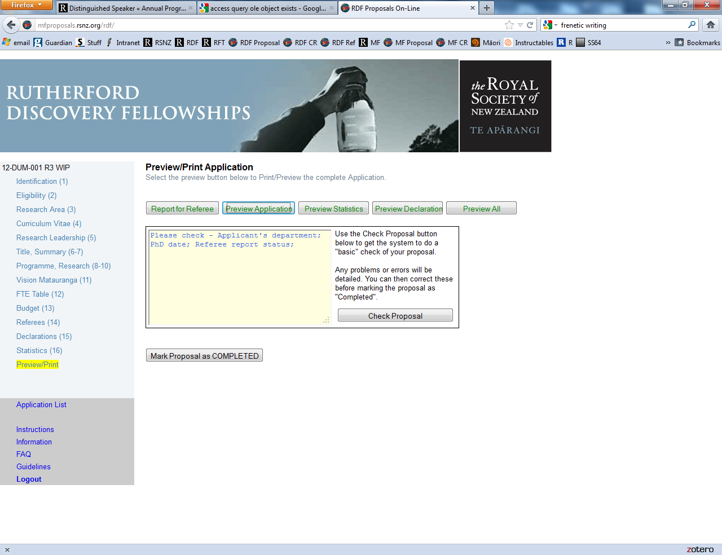
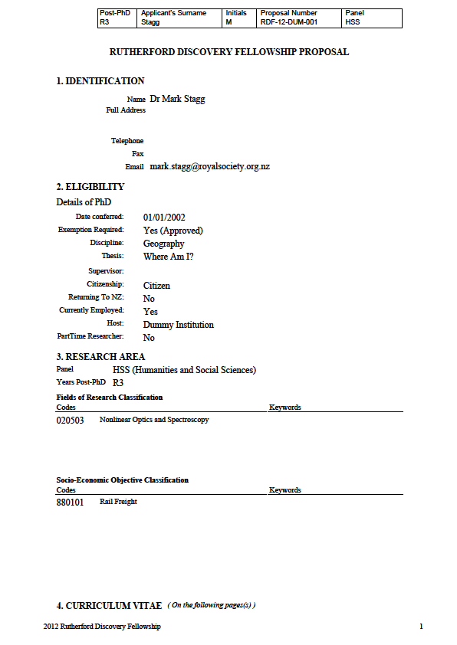
Proposals On-Line
Proposals are to be submitted on the web-based system, Proposals On-Line.
Researchers must contact their host institution’s research office coordinator to obtain their login details for the Proposals On-Line system.

Slide 37
Interview
  The interviews are 20 minutes in duration
  The first ten minutes are an opportunity to outline your proposal
    A data show will be available and if desired you can present up to six PowerPoint slides
  For the remainder of the interview the panel will engage with you in a question and answer format
  Non-successful interviewees are encouraged to contact the Chair of the Interview Panel for feed-back
  Relax and enjoy

Slide 38
2023 RDF Timetable
Date | Activity
Early March | Proposals On-Line web-based application system opens.
Thu 27 April | On-Line web portal closes at 5 pm (New Zealand Standard Time).
Thu 25 May | Deadline for receipt of applicant-solicited referee reports by the Secretariat of the Rutherford Discovery Fellowships at 5 pm (New Zealand Standard Time).
Thu 06 July | Last day for discipline-based panellists to submit their recommendations to the Secretariat.
Tue 18 July | The long-listed proposals are sent to the interview panel.
Fri 18 August | Last day for interview panellists to submit their recommendations to the Secretariat.
Fri 25 Aug | Interview panel selects a short list of candidates to interview. Outcome letters distributed in early September
4-5 October | Interviews conducted by the interview panel. Dates to be confirmed.
Oct (TBC) | Results announced.

Slide 39
Feedback
Summary of how assessed in each criteria in the form of quartiles
A general statement with summary statistics about the funding round will also be prepared

Slide 40
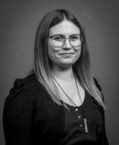
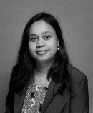
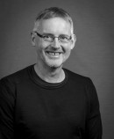
For more information
Rutherford Discovery Fellowship
Email:rutherford.discovery@royalsociety.org.nz
Website: https://royalsociety.org.nz/what-we-do/funds-and-opportunities/rutherford-discovery-fellowships/
Grace O'Leary
Kaiarotake Rangahau Research Assessor
Dr O'Leary is from Te Arawa, Rotorua. She is a social scientist with a background in sociology and feminist geography. Her research interests include social theory, deviance, gender, subjectivity, and bodies within sporting spaces.
Kalpani Somarathne
Kaiarotake Rangahau Research Assessor
Kalpani has a research background in organic synthetic chemistry, particularly in carbohydrate chemistry. After successfully completing a PhD in organic chemistry from Victoria University of Wellington, Kalpani worked for a pharmaceutical company (BDG Synthesis Ltd) as an organic chemist and for MBIE as an assessor assistant.
Troels Petersen
Kaiwhakahaere Kaupapa Motuhake Ao Whānui
As Kaiwhakahaere Kaupapa Motuhake Ao Whānui Programme Manager—Research Fellowships & International, Troels is responsible for coordinating the smooth running of the Rutherford Discovery Fellows, Rutherford Foundation Trust, James Cook, and Catalyst Funds. He is also responsible for the ongoing assessment of these funding contracts. He has a research background in immunology.

