Slide 1
ORCID – a brief overview
ITP Research Symposium 24 September 2020
Presenter – Jill Mellanby
Date – 24 September 2020

Slide 2
What is it?
Two things:
1. Persistent person identifier for researchers (FREE)
Names are not unique enough to identify people.
2. System to system interactions for member organisations (COST – but paid by MBIE)
(Publishers, funders, research organisations). Machine readable information that can be reused e.g. for reporting purposes, saving everyone time.

Slide 3
Why use ORCID?
Researcher
Instead of filling in the same information over and over to your employer; funder etc, simply supply your ORCID ID
Save time
Member organisation
Write information – control how your organisation’s name is used
Read information – collect ORCID IDs and reuse the information in your reporting systems
Save time – accurate data collection
ORCID enter once – reuse often

Slide 4
What goes into an ORCID record?
Affiliations:
Employment
Education and qualifications
Membership and service
Invited positions and distinctions
Funding
Works (Research Outputs)
Peer review activity
Research resources (‘things’ used to carry out research, e.g. equipment, special collections, field sites, etc.)
Also keywords, other names, websites, other IDs, biography

Slide 5
How does information get into ORCID?
Record holder writes it themselves
– may be unreliable; takes time and energy
ACTION – give permission to trusted third parties to write accurate information for you
Third parties get permission from the record holder to read from/write to the record
– reliable, verified sources of information that can be reused for reporting purposes.
Third party can be:
employer, education provider, publisher, funder, peer-review organiser (journal, conference organiser), research facility owner.
ACTION – request permission to read from/write to the ORCID records of your researchers

Slide 6
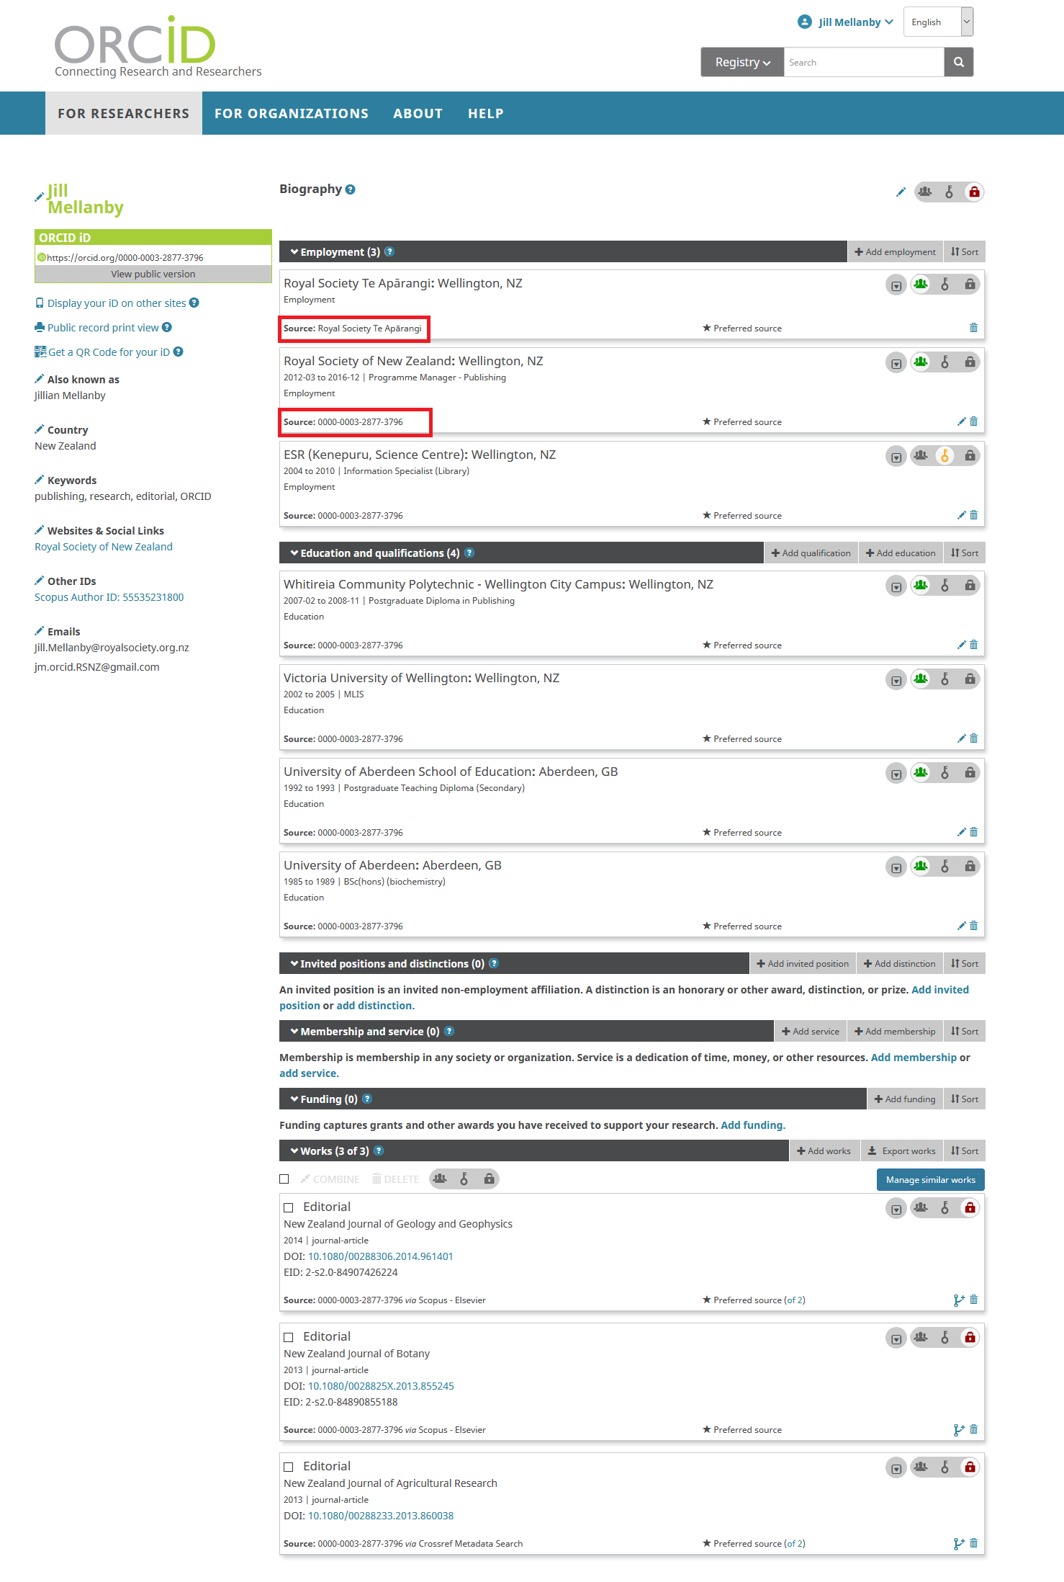

Slide 7
Member organisations - how to request permission to read from/write to ORCID records and act on it
1. Use the New Zealand ORCID Hub
– a simple web application to let you read from and write to ORCID records – once you have obtained permission.
If you can make up a spreadsheet and use email, you can use the Hub - simple user interface.
Full user support.
OR
2. Build an ORCID integration with your own internal systems.
Requires technical expertise. We can assist.

Slide 8
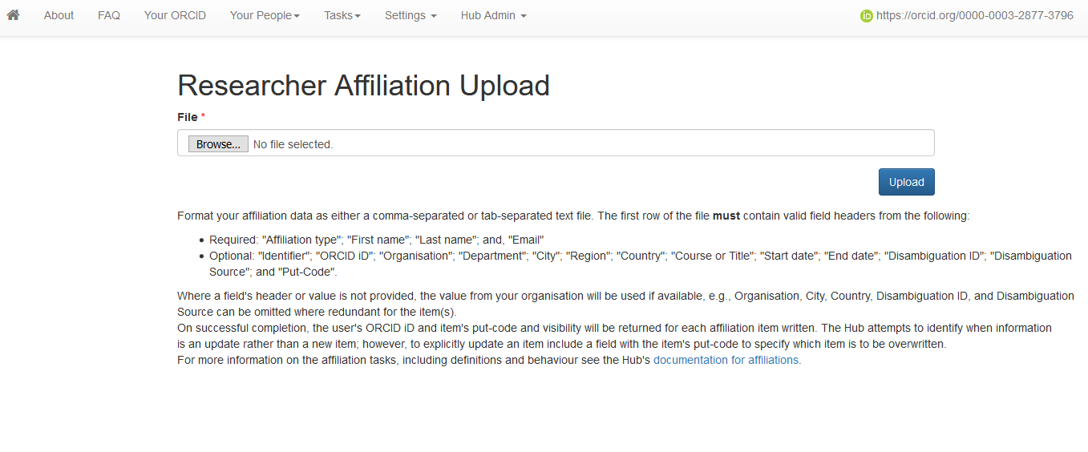
NZ ORCID Hub

Slide 9
New Zealand ORCID Consortium
Fully funded by MBIE - No cost for eligible members
52 members currently:
All universities
Many research funders
All CRIs
11 ITPs
6 district health boards
One museum
ITP members
Ara Institute of Technology / Eastern Institute of Technology/ WelTec and Whitireia / Unitec Institute of Technology / Manukau Institute of Technology / Otago Polytechnic / Toi Ohomai Institute of Technology / Waikato Institute of Technology / Universal College of Learning / Open Polytechnic

Slide 10
Advisory Committee
Representatives from the major consortium sectors
10 people
Meet 2-3 times per year
Provides consortium lead organisation with information relevant to the sectors that make up the consortium – challenges, success stories
Lesley Brook, based at Otago Polytechnic, represents the ITPs

Slide 11
Contact and information
Thank you for listening
email :
orcid@royalsociety.org.nz
More information:
https://www.royalsociety.org.nz/orcid-in-new-zealand/

